Slide 2
Agenda
Understanding the basis of Source Separation via an intuitive example-driven approach
Discussion of experiment design
Graph Blind Source Separation
Graph Blind Source Separation results
Summary of major outcomes
Problems and future research

Slide 3
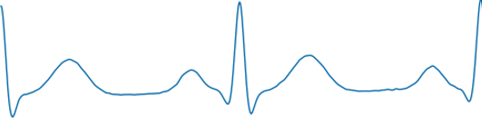
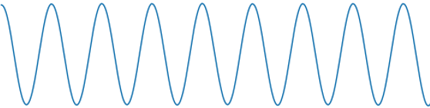
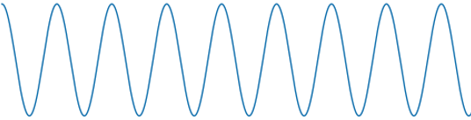
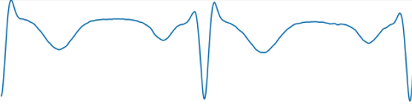
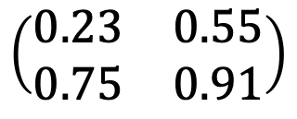
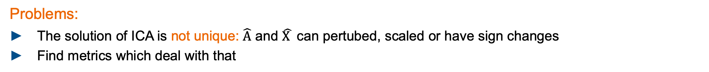
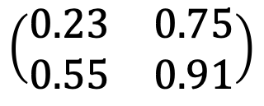

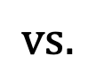


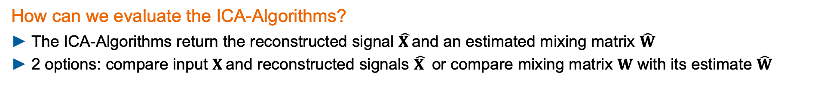

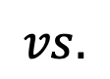
Experiment Design Goal
Goals of this project:
Evaluate ICA - Algorithms in terms of robustness
Elaborating new approaches to increase robustness against noise and outliers in EEG - measurements
How can we evaluate the ICA-Algorithms?
The ICA-Algorithms return the reconstructed signal $\hat{X }$and an estimated mixing matrix $\hat{W}$
2 options: compare input $X$and reconstructed signals $\hat{X }$ or compare mixing matrix $W$ with its estimate $\hat{W}$
$$vs.$$
$$\left(\begin{matrix}0.23 & 0.75 \\ 0.55 & 0.91\end{matrix}\right)$$
$$vs.$$
$$\left(\begin{matrix}0.23 & 0.55 \\ 0.75 & 0.91\end{matrix}\right)$$
$$X$$
$$\hat{X }$$
$$W$$
$\hat{W}$
Problems:
The solution of ICA is not unique: $\hat{A}$ and $\hat{X }$ can pertubed, scaled or have sign changes
Find metrics which deal with that

Slide 4
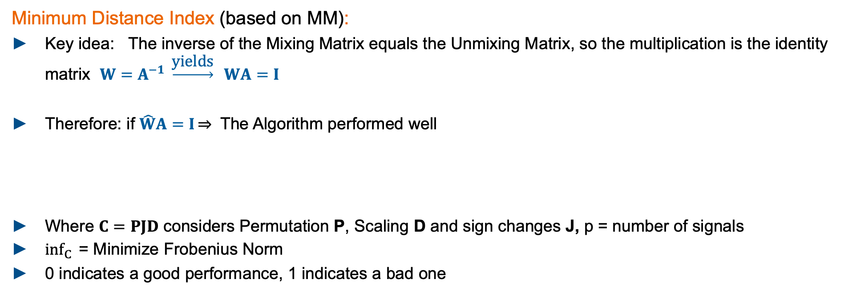
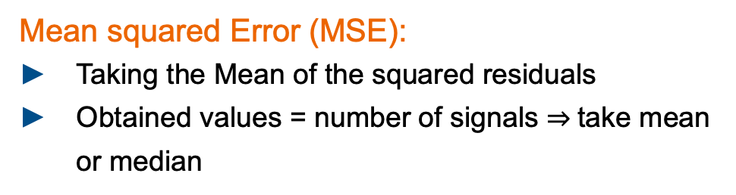
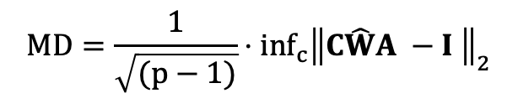
Experiment Design Metrics: MD, MSE
Minimum Distance Index (based on MM):
Key idea: The inverse of the Mixing Matrix equals the Unmixing Matrix, so the multiplication is the identity matrix $W=A^{−1} \underset{→}{\text{yields}} WA=I$
Therefore: if $\hat{W}A=I\overset{⇒}{}$ The Algorithm performed well
Where $C=PJD$ considers Permutation P, Scaling D and sign changes J, p = number of signals
$inf_{C}{ }$= Minimize Frobenius Norm
0 indicates a good performance, 1 indicates a bad one
$$MD=\frac{1}{\sqrt{(p−1)}}⋅inf_{c}{{\left\|C\hat{W}A −I \right\|}_{2}}$$
Mean squared Error (MSE):
Taking the Mean of the squared residuals
Obtained values = number of signals take mean or median
Problem:
Required groundtruth data for X and W
residuals

Slide 5
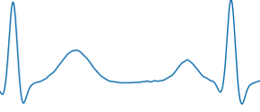
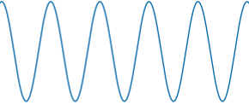
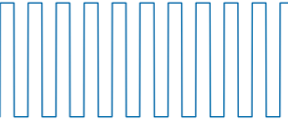
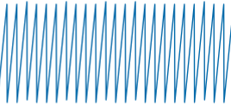
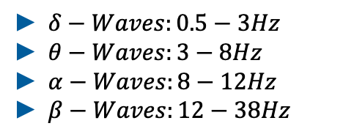
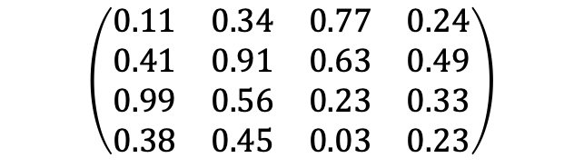


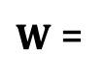
Experiment Design General approach
What we did:
We generated ideal Input Signals $X∈ ℝ^{4xN}$ and a random Mixing Matrix. $W ∈ ℝ^{4x4}$ groundtruth
From us defined Standard Signals
Groundtruth mixing matrix $W$
$$\left(\begin{matrix}0.11 & 0.34 & 0.77 & 0.24 \\ 0.41 & 0.91 & 0.63 & 0.49 \\ 0.99 & 0.56 & 0.23 & 0.33 \\ 0.38 & 0.45 & 0.03 & 0.23\end{matrix}\right)$$
$W$ =
Frequencies of Brainwaves [3]:
ECG Signal: 2Hz
Sinus: 5Hz
Rectangle: 10Hz
Sawtooth: 25Hz
fs: 1000Hz
Normalized to [-1,1]
$δ−Waves:0.5−3Hz$
$θ−Waves:3−8Hz$
$α−Waves:8−12Hz$
$β−Waves:12−38Hz$

Slide 6

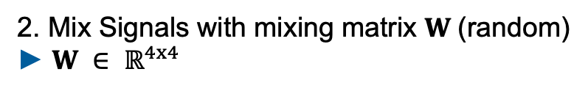

Experiment Design Monte Carlo Flow Chart
Input Signals
Standard input signals
ECG, Sinus, Rectangle, Sawtooth
Runs = 1000
2. Mix Signals with mixing matrix $W$(random)
$W ∈ ℝ^{4x4}$
Mix Signals
Contaminate Signals
3. Contaminate signals
Add single or patchy Outlier (100std) and/or white noise (40dB)
Whitening
4. Whitening process
Decorrelate Signals: meaning that the sample covariance matrix is diagonal and that all the diagonal elements are equal.
ICA
5. Perform ICA
4 Algos: JADE, RADICAL, CoroICA, PowerICA
$$\hat{X}$$
$$\hat{W}$$
Evaluate on Metrics
6. Evaluate single run
Minimum Distance, MSE
7. Evaluate ICA
Get 1000 MDs and MSEs.
Empirical Data Analyses
BoxPlot

Slide 7

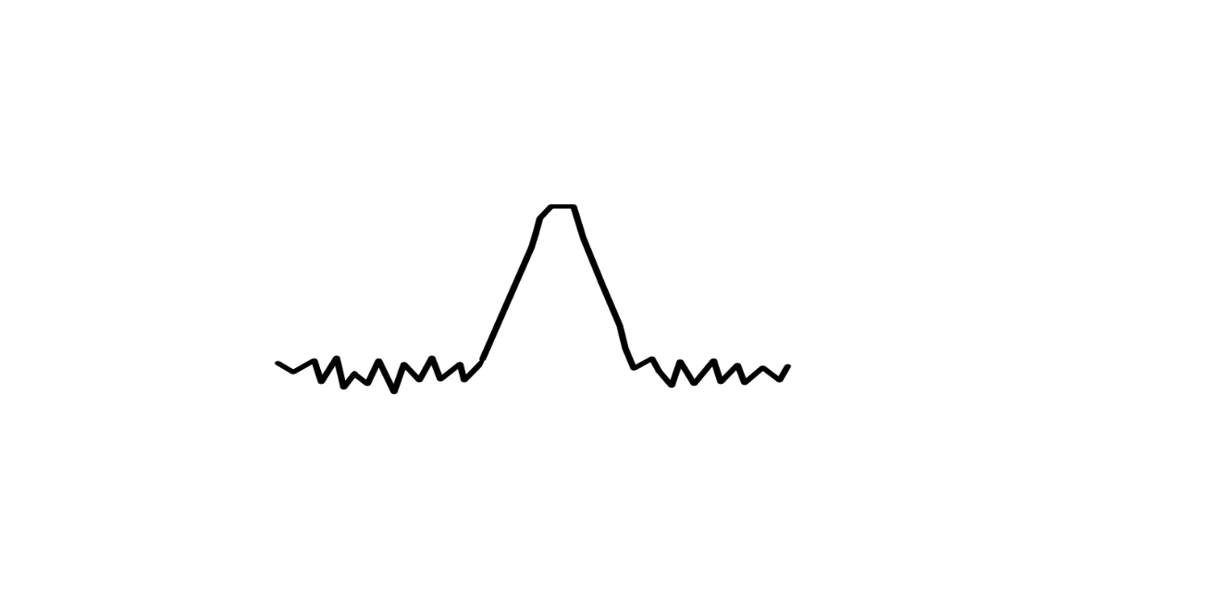
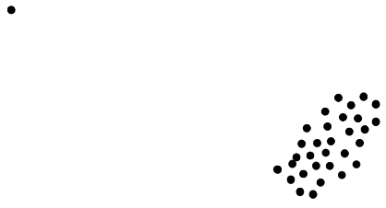
Experiment Design Definition of test characteristics
1.) Focus on Sample Size
Initialize standard signals with different Sample Sizes: 1000, 2500, 5000, 10000, 15000 evaluate on 1000runs
N
Type I: No Noise, No Outlier
Type II: 40dB SNR, No Outlier
Type III: No Noise, 0.1%
Outlier(std = 100)
Type IV: 40dB SNR,
0.1% Outlier (std = 100)
2.) Focus on amount of noise – Breakdown Analyses
Initialize standard signals with fix Sample Size of 10000
Type V: increase noise, SNR: 40 dB,
30 dB, 20 dB, 10 dB, 6 dB, 3 dB
Notes:
ICONS !!!

Slide 8
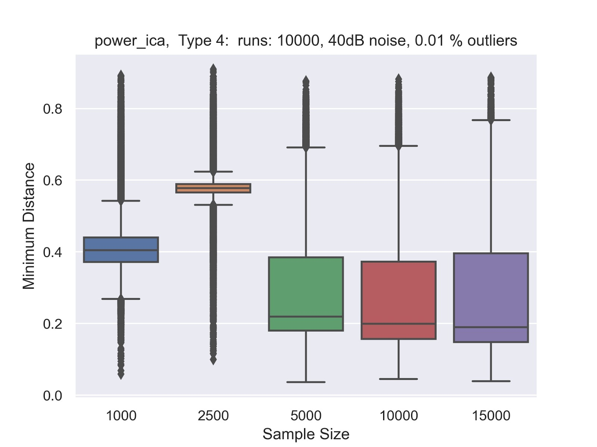
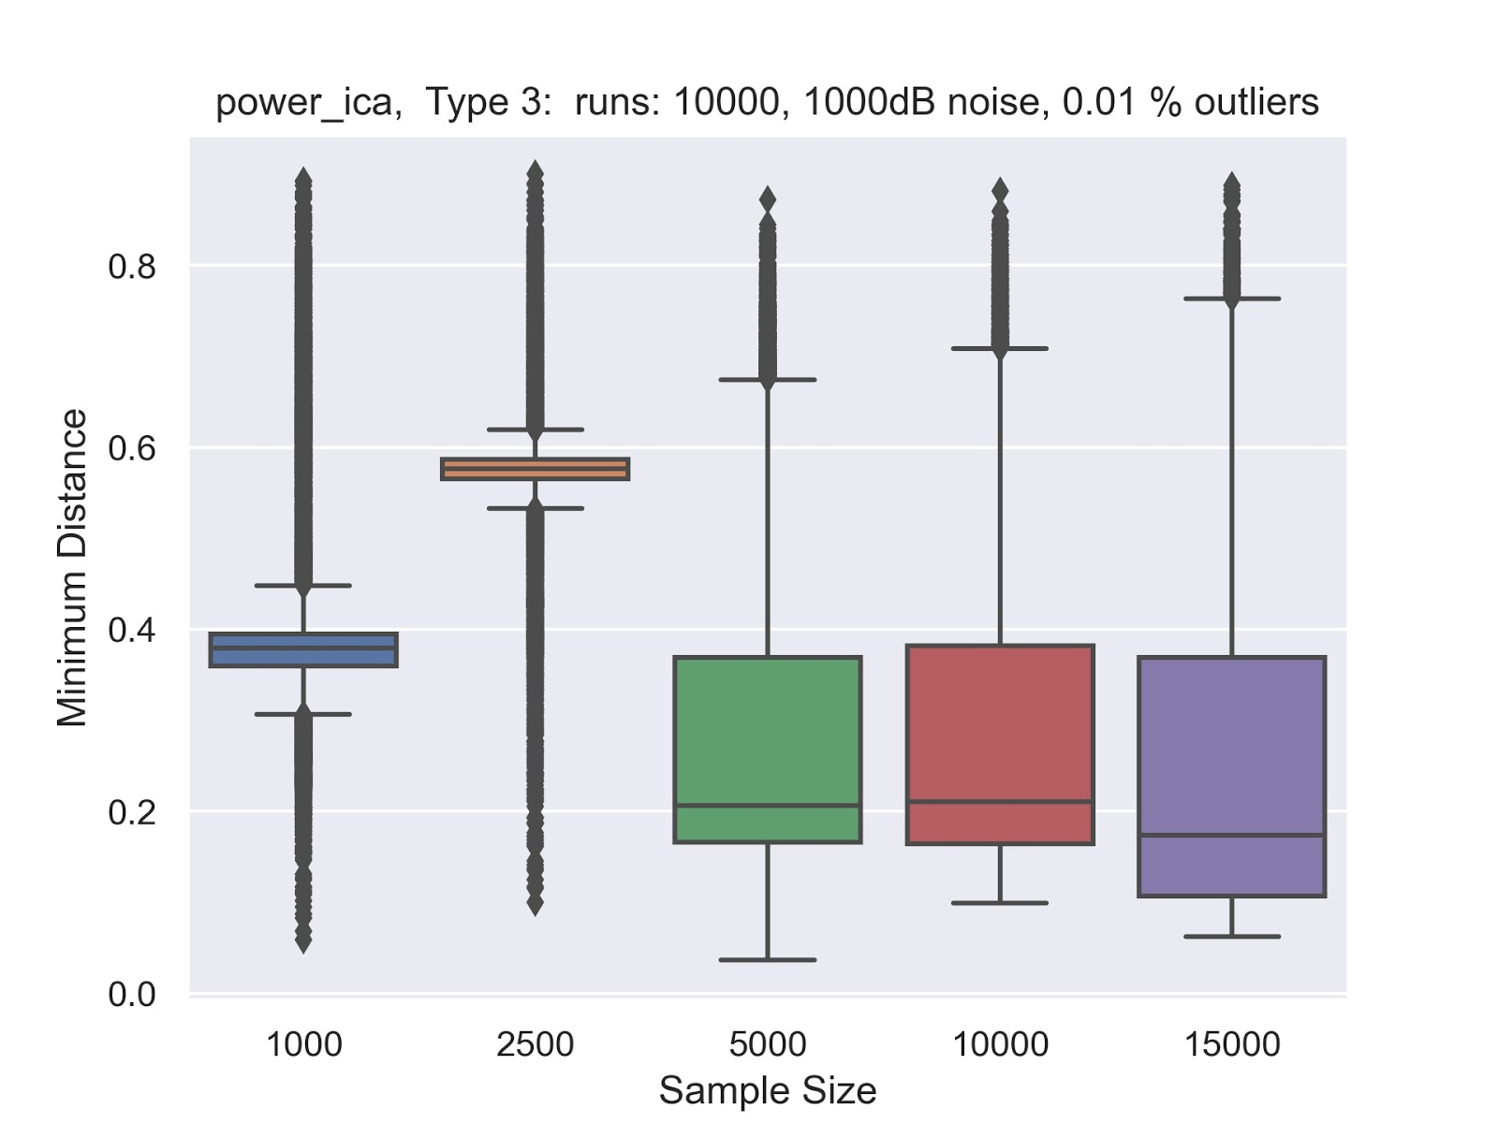
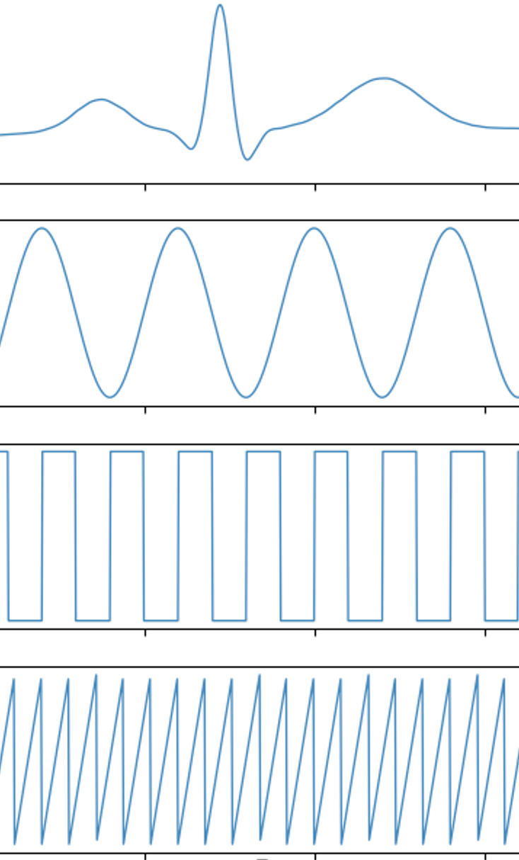
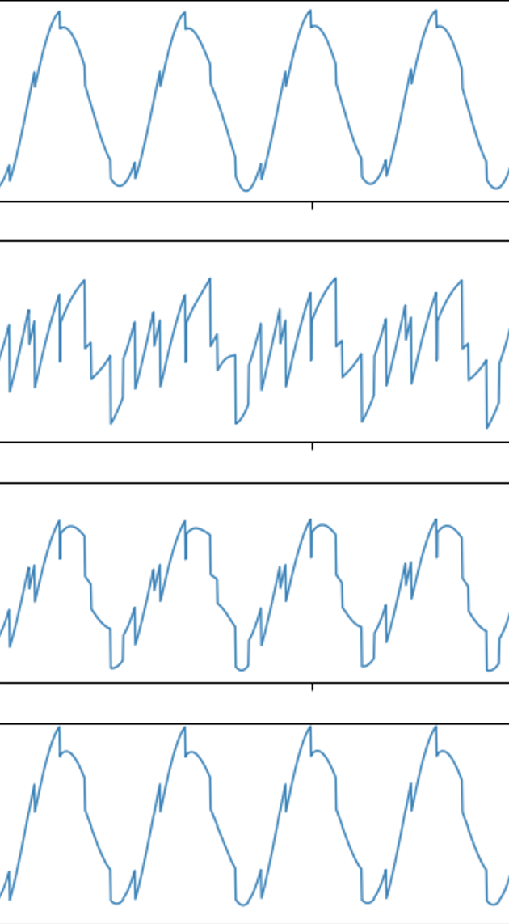
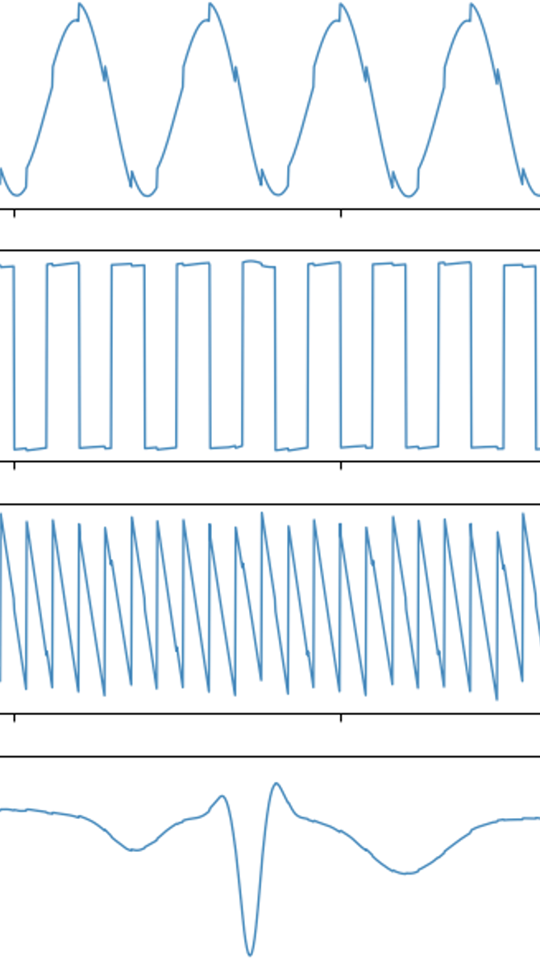

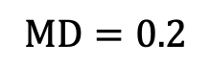
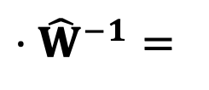
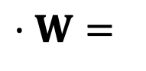
Results Interpreting the Minimum Distance
MD = 0.4
$$⋅W=$$
$$⋅{\hat{W}}^{−1}=$$
MD = 0.6
$$MD=0.2$$
$MD=0.2$ : Good results, small spikes, some sign changes
Notes:
MD not linear ..

Slide 9
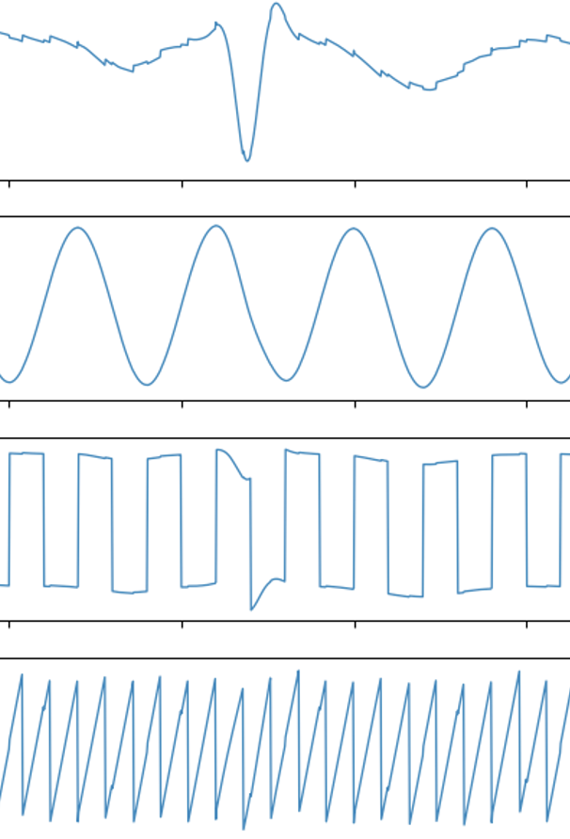
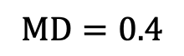

Results Interpreting the Minimum Distance
MD = 0.4
$$⋅W=$$
$$⋅{\hat{W}}^{−1}=$$
MD = 0.6
$$MD=0.4$$
$MD=0.2$ : Good results, small spikes, some sign changes
$MD=0.4$: signals are recognizable, bigger spikes

Slide 10
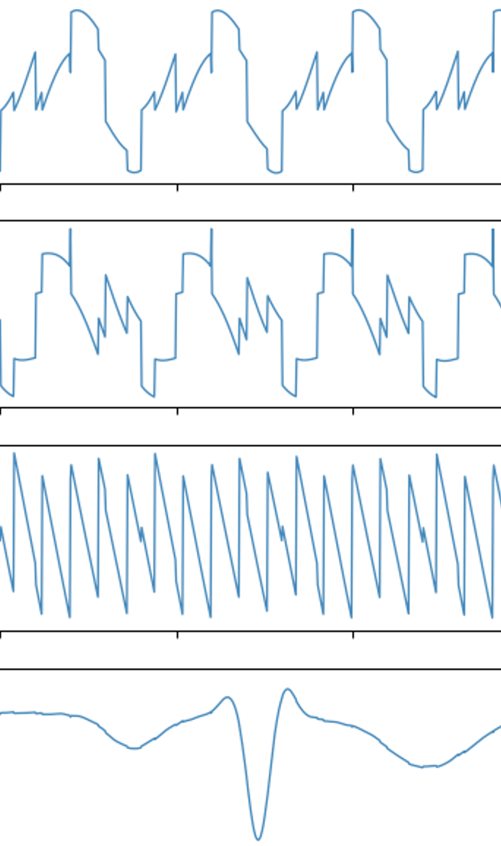
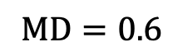
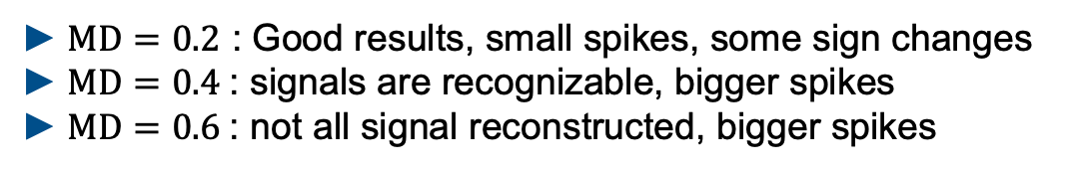
Results Interpreting the Minimum Distance
$$⋅W=$$
$$⋅{\hat{W}}^{−1}=$$
$$MD=0.6$$
$MD=0.2$ : Good results, small spikes, some sign changes
$MD=0.4$: signals are recognizable, bigger spikes
$MD=0.6$: not all signal reconstructed, bigger spikes
Notes:
MD no linear measure – see 0.4 to 0.6

Slide 11
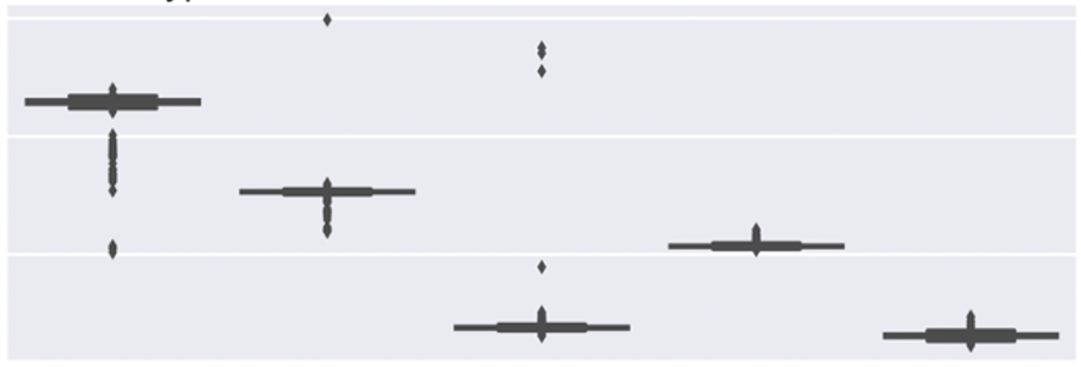
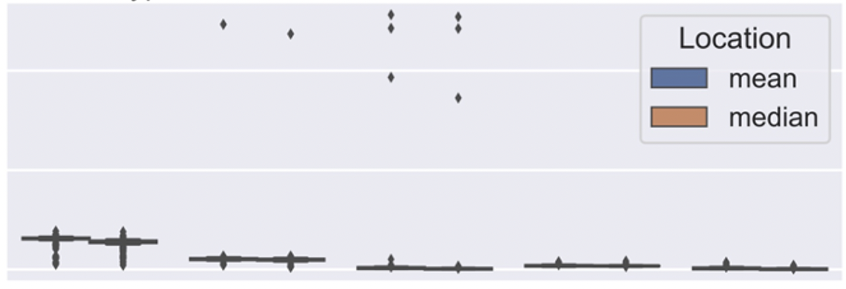
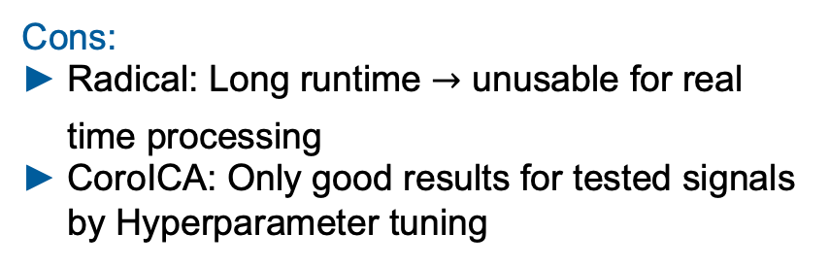
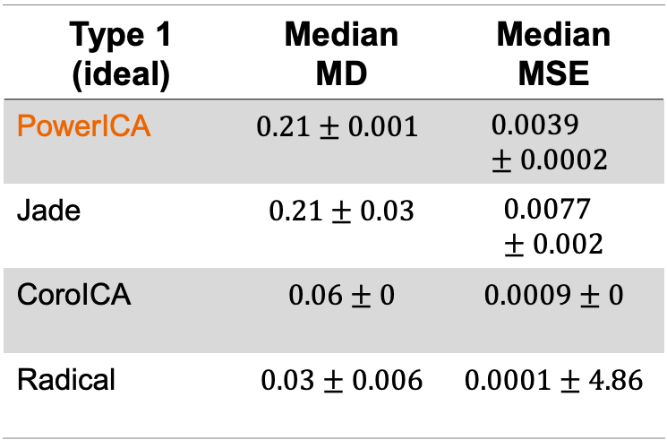
Experiment results Type 1
PowerICA – Type 1: No Noise, No Outlier
Sample Size 10000
0.6
Type 1 (ideal) | Median MD | Median MSE
PowerICA | $$0.21±0.001$$ | $$0.0039±0.0002$$
Jade | $$0.21±0.03$$ | $$0.0077±0.002$$
CoroICA | $$0.06±0$$ | $$0.0009±0$$
Radical | $$0.03±0.006$$ | $$0.0001±4.86$$
MD
0.4
0.2
0.2
MSE
0.1
0.0
1000
2500
5000
10000
15000
Sample Size
Pros:
All Algorithms are able to reconstruct the source signals
Cons:
Radical: Long runtime unusable for real time processing
CoroICA: Only good results for tested signals by Hyperparameter tuning
Notes:
Explain Plot, Examplarly plotted PowerICA here,
MD and Mse are going down for higher samples sizes
All Algorithms were good in the ideal case, shown here are the MDs and MSEs for all algorithms
And now we look on type 1-4

Slide 12
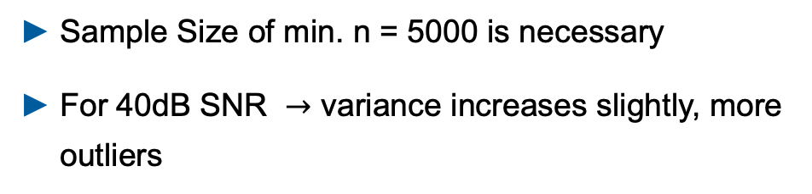
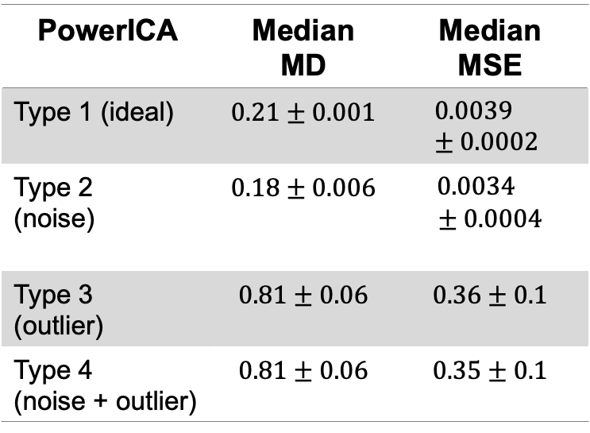
Experiment results Type 1 - 4
PowerICA – Type 1: No Noise, No Outlier
Sample Size 10000
0.6
PowerICA | Median MD | Median MSE
Type 1 (ideal) | $$0.21±0.001$$ | $$0.0039±0.0002$$
Type 2 (noise) | $$0.18±0.006$$ | $0.0034$ $$± 0.0004$$
Type 3 (outlier) | $$0.81±0.06$$ | $$0.36±0.1$$
Type 4 (noise + outlier) | $$0.81±0.06$$ | $$0.35±0.1$$
MD
0.4
0.2
0.2
MSE
0.1
0.0
1000
2500
5000
10000
15000
Sample Size
Sample Size of min. n = 5000 is necessary
For 40dB SNR variance increases slightly, more outliers
Even 0.1% Outlier causes failure for every algorithm
Hop at 10000: Drawback of the MD – metric is not perfect
Next Step:
Breakdown Analyses – How much noise does it take to cause a breakdown?

Slide 13
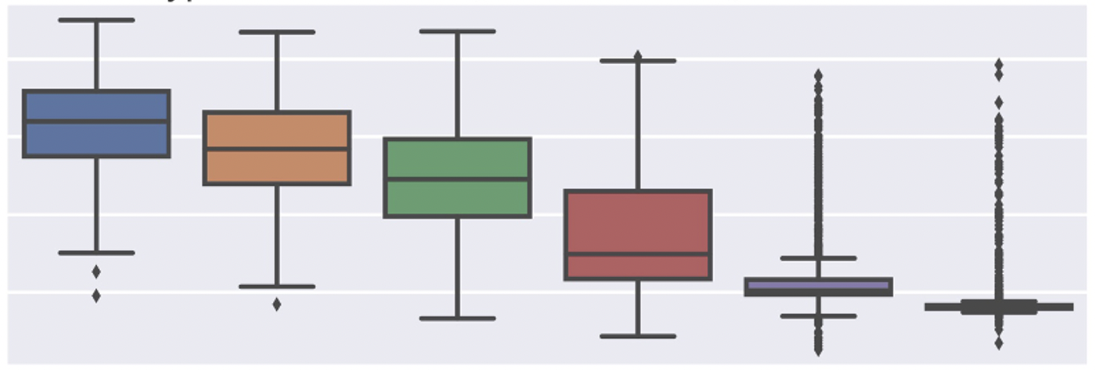
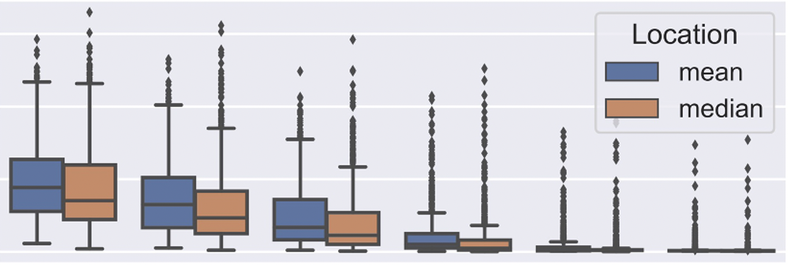

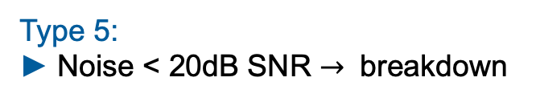
Experiment results Type 5
Power ICA – Type 5: 3-40dB Noise, No Outlier
0.8
Type 5:
Noise < 20dB SNR $→$ breakdown
MD
0.6
0.4
0.2
Did our robustness plugins improve the results ?
0.6
0.4
Robust Covariance Estimation in Whitening:
Could not prevent breakdown
Occasionally causes breakdown
Robust objective Function in higher Order statistics:
Could not prevent breakdown
Occasionally causes breakdown
MSE
0.2
0.0
3.0
6.0
10.0
20.0
30.0
40.0
SNR (additive noise)
Intermediate conclusion:
Pre-processing of the data essential! $→$Outlier removal + smoothing
We need new approaches to improve the performance
Notes:
We decreased SNR from 40dB to 3db …

Slide 14
Literature
[Delorme2007] - Enhanced detection of artifacts in EEG data using higher-order statistics and independent component analysis in NIH 2007
[2] - https://mne.tools/dev/overview/datasets_index.html visited 02.16.2021
[3] - https://brainworksneurotherapy.com/what-are-brainwaves

Slide 15
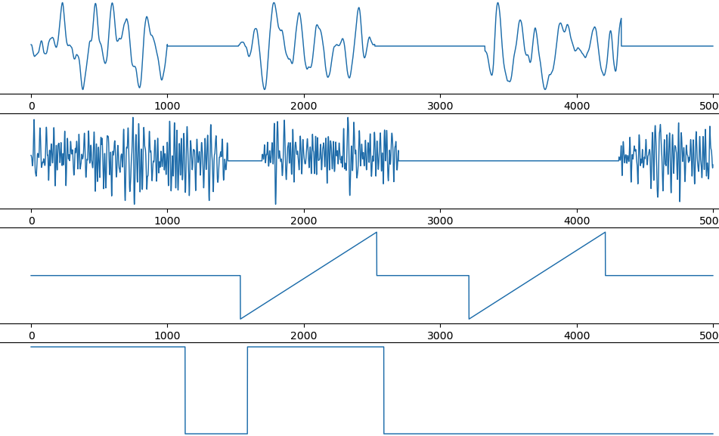
Towards EEG data Synthetic EEG artifact reconstruction
Synthetic - EEG data
1. Use standard signals as input signals
2. Mix Data with random mixing matrix
3. We generated realistic artifacts and added one on each channel
Artifacts which typically come along with EEG data [Delorme2007]
Optional: Add single or patchy (100std) Outliers and white noise (3std)
Realistic artifacts [Delorme2007]
Eye Blink
Muscle
Electrical
Electrical
4. Performed ICA
Notes:
Low frequency events – modelling eye Blink artifacts around 1-3Hz
Transient high frequency events 20-60Hzmodelling muscle artifacts
Signal discontinuities from electrical artifacts
Linear trends from eletrical artifacts

Slide 16
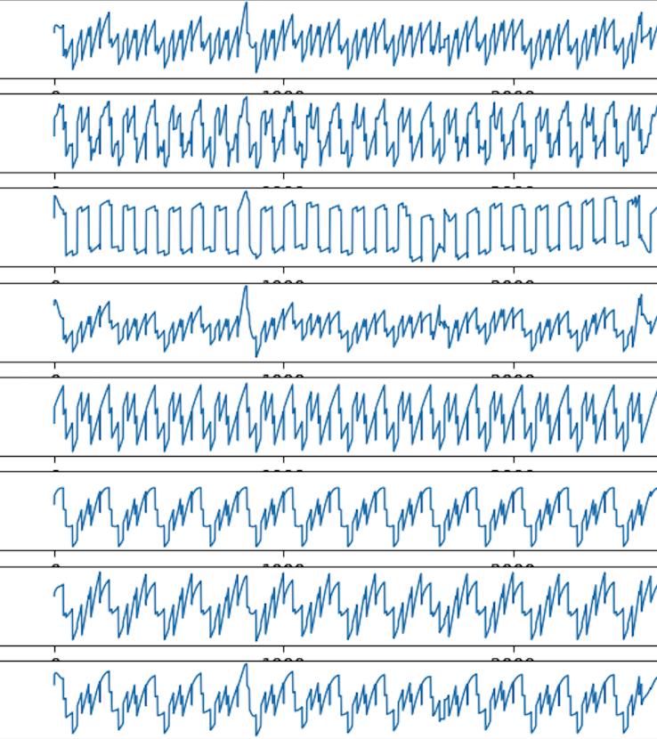
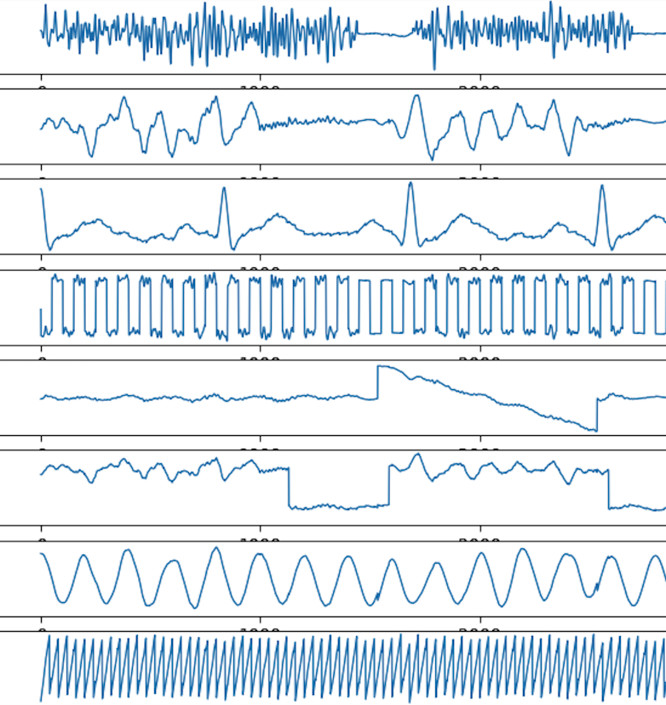
Towards EEG data Results with synthetic EEG data
Mixed signals + added artifacts
Reconstructed signals + artifacts
Muscle
Eye Blink
PowerICA
electrical
electrical
Able to reconstruct the standard signals and the EEG artifacts

Slide 17
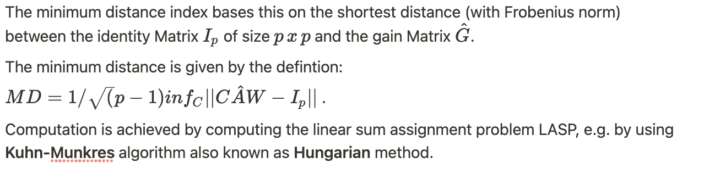
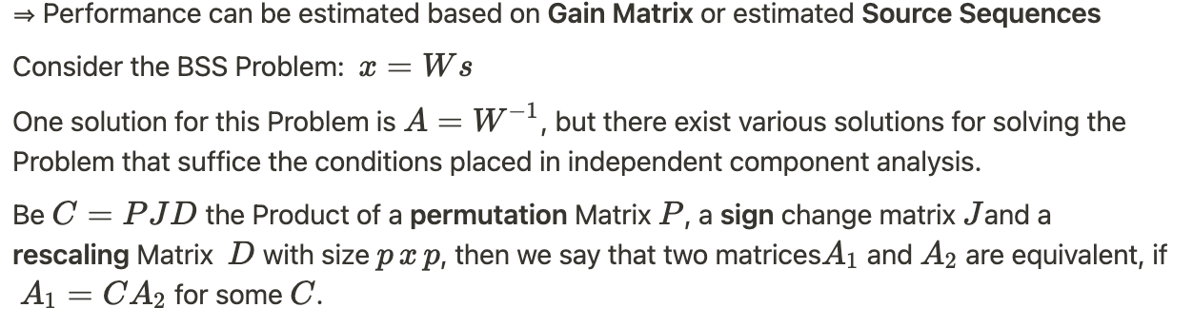
Minimum Distance
MD of 0 -> good, MD->1 bad, Optimum = Identity, Only possible if Groundtruth
available

Slide 18


Results Type 1 - 4
Power ICA
PowerICA | Median MD | Median MSE | Median SNR [dB]
Type 1 (ideal) | $$0.21±0.001$$ | $$0.0039±0.0002$$ | $$24.16±0.21$$
Type 2 (noise) | $$0.18±0.006$$ | $0.0034$ $$± 0.0004$$ | $$25.93±0.63$$
Type 3 (outlier) | $$0.81±0.06$$ | $$0.36±0.1$$ | $$5.3±1.8$$
Type 4 (noise + outlier) | $$0.81±0.06$$ | $$0.35±0.1$$ | $$5.47±1.78$$
Next Step:
How much noise does it take to cause a breakdown ?
Sample Size of min. n = 5000 is neccessary
Even 0.1% Outlier causes failure for every algorithm
For 40dB SNR -> variance increses slightly, more outliers

Slide 19



MSE, SNR
Evaluate for every single signal

